Slide 1
RUNGTA COLLEGE OF DENTAL SCIENCES & RESEARCH
TITLE OF THE TOPIC: STERILISATION AND DISINFECTION
DEPARTMENT OF CONSERVATIVE DENTISTRY AND ENDODONTICS

Slide 2
Specific learning Objectives
At the end of this presentation the learner is expected to know ;
Core areas* | Domain ** | Category #
ANATOMY OF PERIAPEX CEMENTUM PERIODOTAL LIGAMENT INGLES CLASSIFICATION ZONES OF FISH | COGNITIVE | MUST KNOW
PATHWAY OF ENTRY OF MICROORGANISMS IN TOOTH | PSYCHOMOTOR | NICE TO KNOW
DIAGNOSIS OF PERIAPICAL TISSUE ENDO PERIO LESSIONS | AFFECTIVE | DESIRE TO KNOW

Slide 3
Content INTRODUCTION Chain of Infection FEDERAL AND STATE REGULATIONS OSHA regulations

Slide 4
INTRODUCTION
Increase in serious transmissible diseases over last few decades has created global concern and affected the treatment approach of all health care practitioners.
As most of the human microbial pathogens are isolated from oral secretions, dentists and dental staff members are known to be susceptible to many diseases in office.

Slide 5
Why Is Infection Control Important in Dentistry
Both patients and dental health care personnel (DHCP) can be exposed to pathogens
Contact with blood, oral and respiratory secretions, and contaminated equipment occurs
Proper procedures can prevent transmission of infections among patients and DHCP

Slide 6
DENTISTRY AS PRACTICED IN THE PAST

Slide 7
Novel demonstration by Crawford in 1970 using the premise “if saliva were red”
Study expanded by Glass, Cottene and leuke at the university of Texas dental school

Slide 8
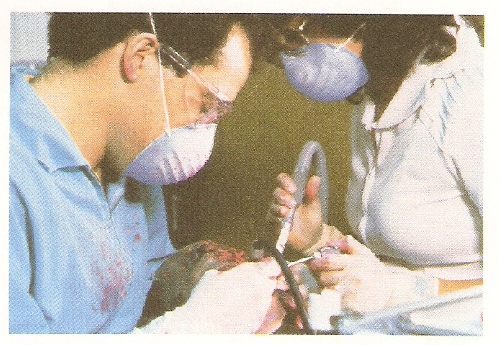

Slide 9
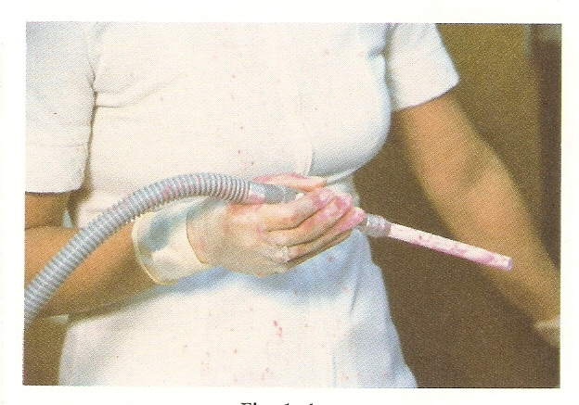

Slide 10
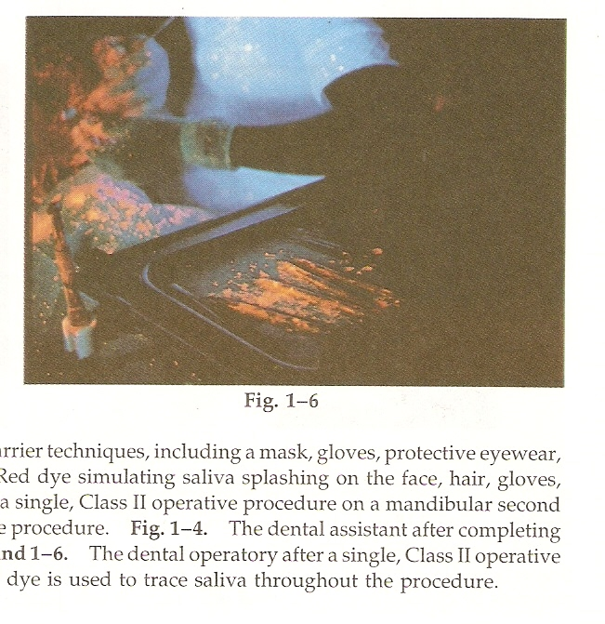
Demonstration of spatter using fluorescent light

Slide 11
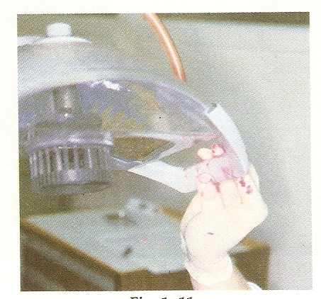
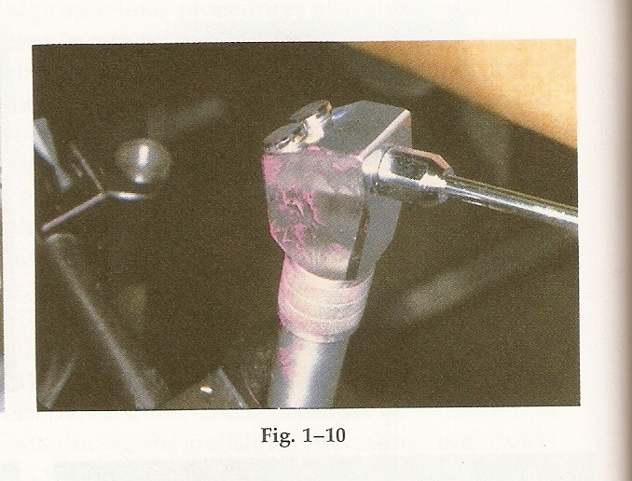
Study conducted by molinary and york

Slide 12
Chain of Infection

Slide 13
Microbial exposure
Air borne contamination
Direct contact
Indirect contact

Slide 14
Air borne contamination
Aerosols
Invisible particles less than 5µm
Can remain suspended in the air and breathed for hours
May carry agents of respiratory infection borne by the patient
Mist
Become visible in the beam of light
Consists of droplets approaching 50µm
Heavy mists tend to settle gradually from air after 5-15 min
Spatter
Particles larger than 50µm-100µm
Spatter fall with in 3ft of pt mouth
It is a potential route of infection for dental personnel by blood borne pathogens

Slide 15
Direct contact
Indirect contact
Air water syringe handle
Control switches
Canisters of treatment materials
Unprotected lamp handles
Rests of dentists and assistant chairs, seat edges
Cabinet, drawer &operating tray handles

Slide 16
Potential Routes of Transmission of Bloodborne Pathogens
Patient
DHCP
DHCP
Patient
Patient
Patient

Slide 17
FEDERAL AND STATE REGULATIONS
CDC and ADA developed infection control program
OSHA final rule published in 1991
OSHA hazard communication program
OSHA blood-borne pathogens program

Slide 18
OSHA regulations
Employers must provide HBV immunization within 10 days of employment
Standard precautions must be followed
Employers must implement engineering controls (precautions) to reduce production of contaminated spatter, mists and aerosols.
Provide facilities and instructions for washing hands
Safe handling of needles and other sharp items.

Slide 19
Employers must provide the necessary PPE and clear directions for use
As soon as possible after treatment, house keeping requirements should be attended.
Employers must provide written schedule for cleaning and decontaminating equipment, work surface and contaminated floors.
Employers must provide laundering of protective garments at no cost.

Slide 20
INFECTION CONTROL GUIDE LINES

Slide 21
Patients medical history
“NEVER TREAT A STRANGER”
SIR WILLIAM OSLER

Slide 22
A thorough medical history should be taken for all new patients
Patients with suspected infectious diseases should be screened
Review and update patients medical history at each appointment.

Slide 23
PURPOSE
To detect unrecognised illness that require diagnosis and care
To identify any infection or high risk
To assist in managing and caring for infected patients
To reinforce use of adequate infection control procedures

Slide 24
Because all the patients with infectious diseases cannot be identified, all body fluids, contaminated instruments and materials should be treated as if they are infectious.
Universal precautions should apply in the treatment of all the patients.

Slide 25
Hand Hygiene
Why Is Hand Hygiene Important?
Hands are the most common mode of pathogen transmission
Reduce spread of antimicrobial resistance
Prevent health care-associated infections

Slide 26
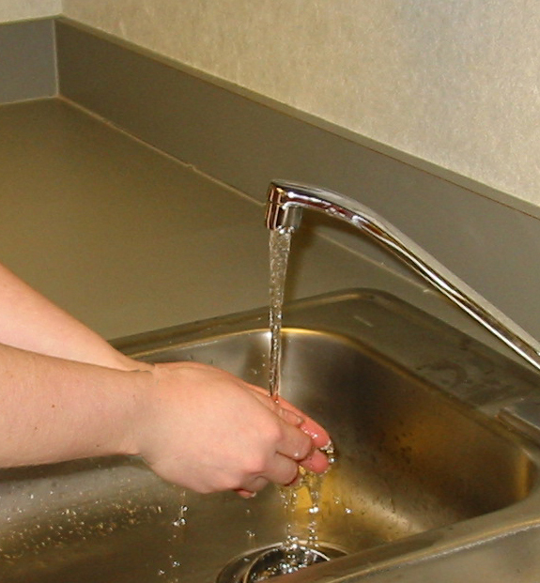
Hands Need to be Cleaned When
Visibly dirty
After touching contaminated objects with bare hands
Before and after patient treatment (before glove placement and after glove removal)

Slide 27
Efficacy of Hand Hygiene Preparations in Reduction of Bacteria
Better
Best
Good
Plain Soap
Antimicrobial soap
Alcohol-based handrub

Slide 28
Special Hand Hygiene Considerations
Use hand lotions to prevent skin dryness
Consider compatibility of hand care products with gloves (e.g., mineral oils and petroleum bases may cause early glove failure)
Keep fingernails short
Avoid artificial nails
Avoid hand jewelry that may tear gloves

Slide 29
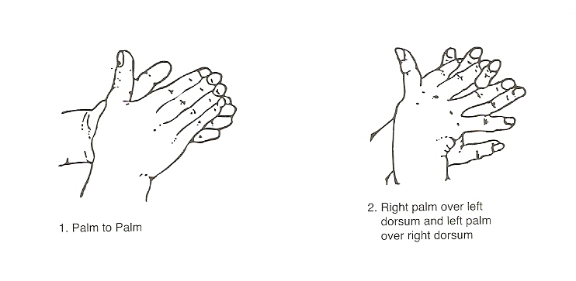
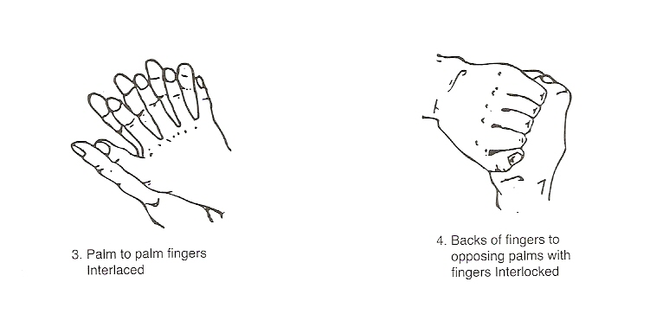
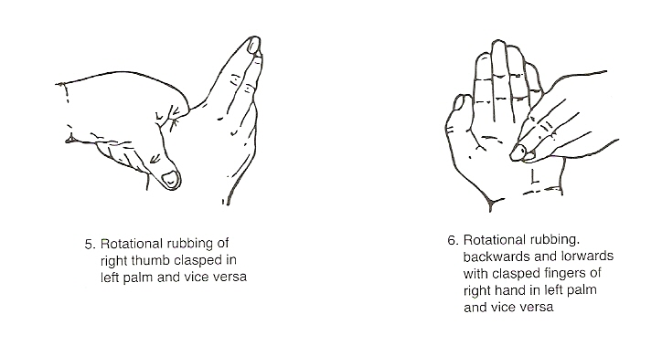
Hand washing
Technique of hand washing

Slide 30
GLOVING DOES NOT REPLACE HAND WASHING
HANDS MUST BE WASHED BEFORE AND AFTER GLOVING
THIS KEEPS THE LEVEL OF BACTERIA TO MINIMUM AND REDUCES THE IRRITATING BUILD-UP OF SKIN BACTERIA THAT MUTIPLY UNDER SKIN

Slide 31
Personnel protective equipment
They provide a physical barrier between the body and source of contamination.
They are
GLOVES
MOUTH MASKS
PROTECTIVE EYE GLASSES
PLASTIC SHIELDS
PROTECTIVE OVER GARMENTS

Slide 32
PPE to comply with OSHA bloodborne disease standard

Slide 33
GLOVES
Minimize the risk of health care personnel acquiring infections from patients
Prevent microbial flora from being transmitted from health care personnel to patients
Reduce contamination of the hands of health care personnel by microbial flora that can be transmitted from one patient to another
Are not a substitute for handwashing!

Slide 34
TYPES OF GLOVES
Sterile or surgeons gloves
Non sterile gloves:
Utility gloves:
Over gloves:

Slide 35
GLOVING

Slide 36
REMOVAL OF GLOVES

Slide 37
MASKS
Reduce inhalation of potentially infectious aerosol particles
When a tooth is cut aerosols are formed. Highest concentration is found with in 2 feet in front of the patient
In a study with serratia marcesens 60% of generated aerosols contained viable particles capable of direct penetration into the alveoli.

Slide 38
During use of high speed turbines bacterial counts may reach 109-300vp per cubic feet of air and a250% increase of bacteria counts measured 35 min after a 1.5-50 min of operative procedure
Organisms derived from aerosols are staphylococci, streptococci, diptheroids, pneumococci, tubercle bacilli, hepatitis virus, influenza virus, nisseria, herpes virus hominis.

Slide 39
Mask should not contact the mouth while being worn
Mask should be changed between every patient or when ever it becomes moist.
Mask should be discarded when the patient is dismissed after treatment instead of wearing it around the neck where contaminated edges can rub against the neck.

Slide 40
TAKE HOME MESSEGE
Some of the problems that dentists face in their clinical practice are caused or facilitated by improper (but sometimes even proper) treatment of the root canal system. In an attempt to accomplish the major goals of root canal treatment, namely to prevent and/or to control endodontic infections, clinicians use procedures, substances and materials that may induce some degree of injury to the periradicular tissues. Invariably, periradicular tissue healing will occur uneventfully in cases where microorganisms were successfully eliminated from and/or prevented from gaining entry into the root canal system and minimal or no damage was inflicted on the periradicular tissues during therapy. The worst-case scenario for periradicular tissue response to intra-canal procedures is reflected largely in post-operative pain and persistence of periradicular disease despite treatment. While the development of post-operative pain is largely a short-term response related to the extent of tissue injury, post-treatment disease is a long-term response influenced by the persistence of the source of injury. Even though chemical and mechanical factors can be involved with unfavorable responses of the periradicular tissues to intracanal procedures, microorganisms are the major causative agents of post-operative pain and posttreatment disease.

Slide 41
Question:
What is sterilization ?

Slide 42
references
Pathways Of The Pulp 6th Edn. & 8th Edn. Cohen
Endodontics Vol 1 Arnaldo Castellucci
Endodontics Ingle 5th Edn.
Colour atlas of Dental Medicine Endodontology
Rudolf Beer, Michael A. Baumann
Text book of Endodontology Bergenholtz Reitz
Endodontic Therapy Weine 5th Edition
Endodontics Vol 1 Arnaldo Castellucci
Color atlas of Endodontics William Johnson
Color Atlas of Endodontics – J.J.Messing & C.J.R Stock

Slide 43
THANK YOU

